Slide 1
The Perfect Recipe
to Make It on
the Music Charts…
Search
Home
Library
Antra Sinha, Anubhav Nehru, Abhijit Anil, Avi Walyat, Gaytri Riya Vasal

Slide 2
Table of Contents
#1
#2
#3
#4
Problem Statement
Data source and Pre-processing
Analysis & Insights
Recommendation

Slide 3
Problem Statement
WHAT?
Identify the recipe for a hit song.
Our objective is to offer music producers and composers valuable guidance and insights on crafting hit songs.
WHY?
Market relevance
Audience engagement
Competitive advantage

Slide 4
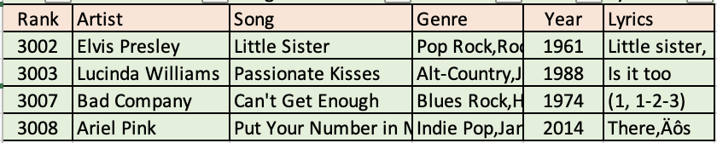
Data source and Pre-processing
Scraped 10k rows from AcclaimedMusic.net to identify the top artist and songs spanning the years 1897 to 2019
For the top 4000 artist and songs we extracted the lyrics from A-Z lyrics
Data Handling
Word tokenization
Removal of stop words, punctuations and irrelevant words from the lyrics (ooh, aah etc.)
Lemmatization

Slide 5
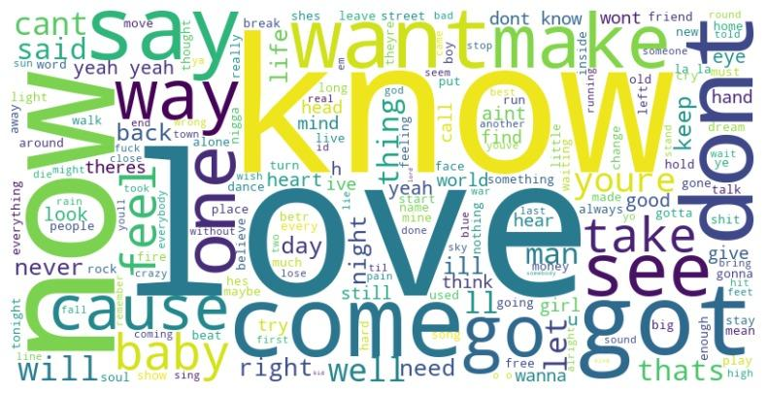
Word Frequency Analysis
Notes:
By doing word frequency analysis, we found that following are the top words -
Now
Love
Know
Dont
Take
See
Got
Come
say

Slide 6
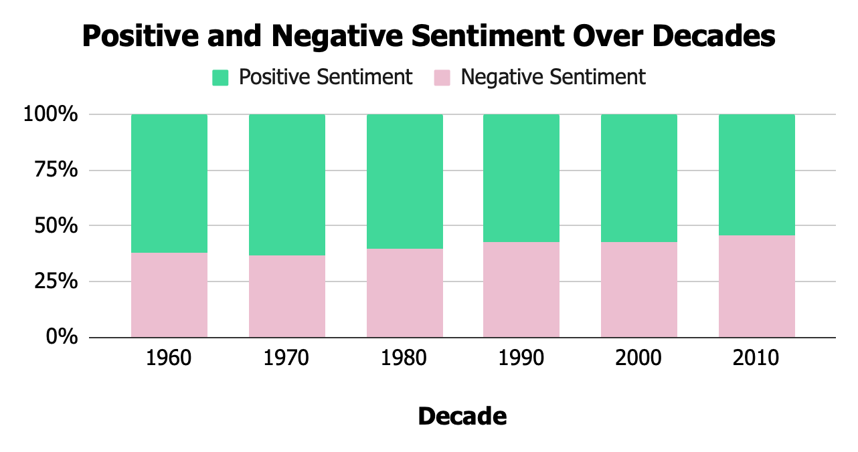
Sentiment Analysis

Slide 7
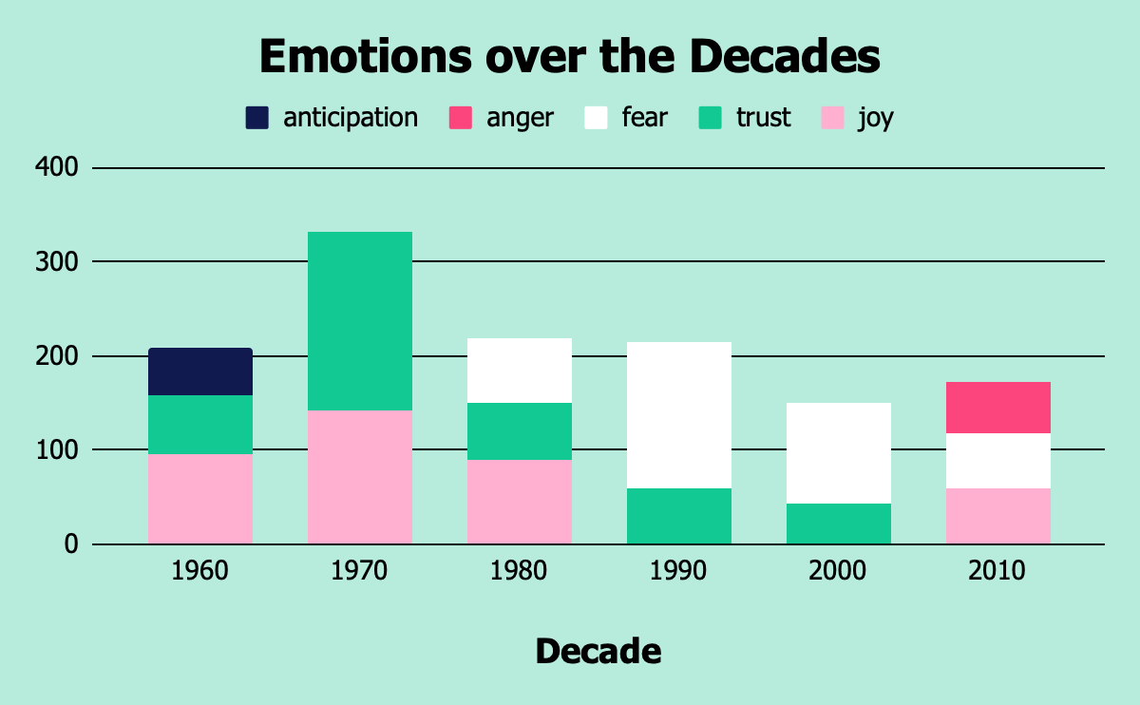
Emotion Analysis

Slide 8
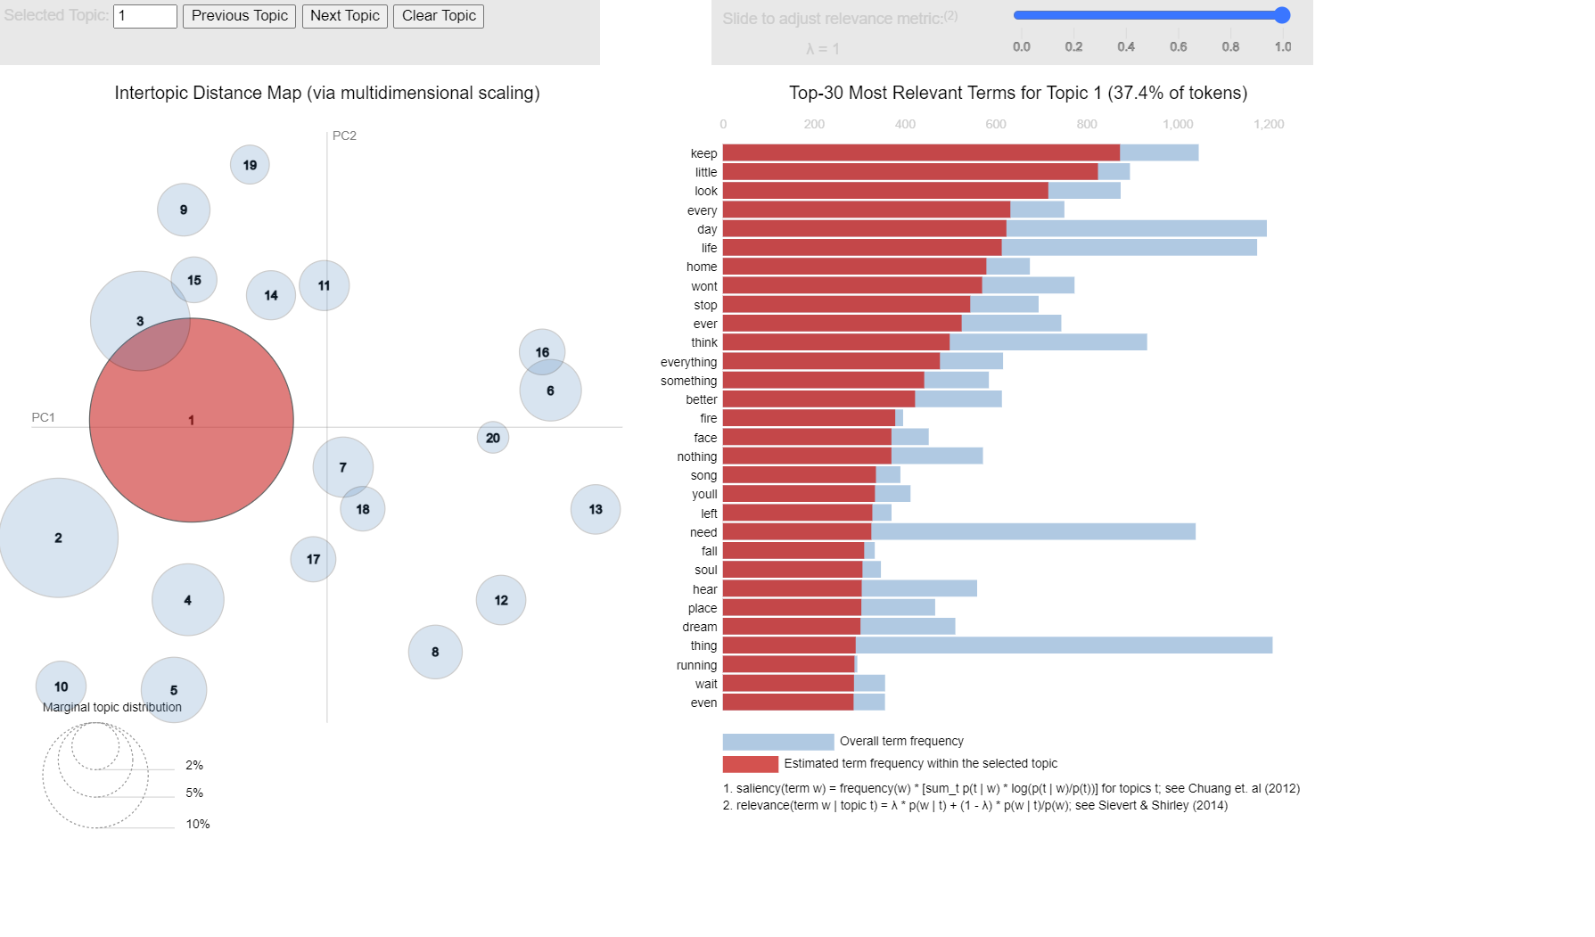
Topic Modelling
Personal themes remain constant in song lyrics across decades. Secondary themes shift from relationships to broader expressions, highlighting the enduring importance of a personal connection with the audience.
Notes:
Keywords for each topic:
Topic 1 (Love): sing, babe, enough, nothing, darling, girl, thing, youve, bring, wont
Topic 2 (Moments): dance, moment, soon, stop, big, tryin, name, afford, next, sweet
Topic 3 (Nightlife): tonight, light, find, move, golden, heart, prove, hand, shine, neon
Topic 4 (Struggles): arm, shame, high, live, wrapped, pain, lose, blame, wouldnt, stay
Topic 5 (Memories): end, radio, remember, need, dream, sound, century, part, fast, past
Topic 6 (Aspiration): higher, gone, electric, hold, wherever, far, black, life, hole, wanted
Topic 7 (World): world, girl, wild, lot, bad, hard, remember, child, always, smile
Topic 8 (Identity): true, color, theyre, lean, blue, show, older, shining, afraid, beautiful
Topic 9 (Rock): rock, avenue, think, street, brain, stand, fill, grow, good, juice
Topic 10 (Relationships): hand, stay, reason, must, someone, would, long, understand, many, lovin
Topic 11 (Desires): shes, break, another, coming, head, round, money, dress, nobody, wish
Topic 12 (Reality): lay, forget, would, nigga, lie, world, shit, need, told, life
Topic 13 (Emotions): give, cry, run, hurt, heart, goodbye, carry, lie, around, desert
Topic 14 (Expressions): really, lord, day, big, fly, boy, good, young, real, huh
Topic 15 (Dance): shake, good, til, turn, thing, early, girl, call, miss, name
Topic 16 (Dreams): weather, always, everywhere, bird, dream, walking, room, lie, nowhere, wash
Topic 17 (Chance & Self): chance, free, honey, still, need, change, mind, alone, pretty, test
Topic 18 (Everyday Life): keep, little, look, every, day, life, home, wont, stop, ever
Topic 19 (Feelings): eye, mind, alright, rain, give, honey, ahead, feeling, somebody, pity
Topic 20 (Women): woman, bleed, round, give, around, would, knew, end, enough, home

Slide 9
Recommendations
Sentiments
1h10min
Mix in more positivity in your tunes, but don't shy away from a bit of realness. Strike that balance – upbeat with a touch of raw emotion – to connect with your listeners on a deeper level.
Emotions
1h20min
Enhance your music with increased joy to offset declining trust emotions, and add a touch of controlled anger for a contemporary edge in line with current trends.
Topics
1h30min
Enhance your songwriting by balancing timeless personal themes with broader expressions, ensuring a deep and lasting connection with your audience.

Slide 10
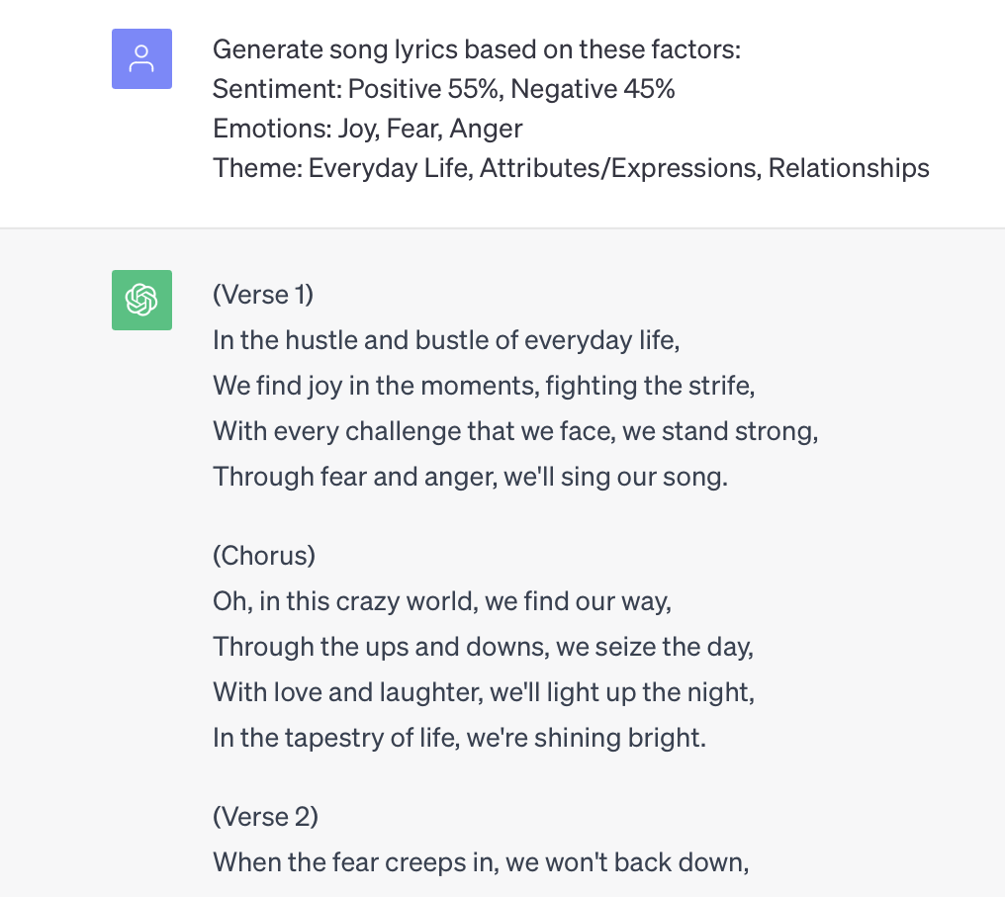
LLMs using our Recipe
Notes:
Link for Full song - https://chat.openai.com/share/7dce8700-ae72-4992-946b-a07515b114c4

Slide 11

Any questions?
Notes:
Kendrick Lamar has been the artist for the Decade 2010-2019

